Slide 1

Community
E-Swap
Shannon Lim (991508798)
Minjung Shim (991465401)
Hatim Sayanwala (991503538)
Team Talent Overflow

Slide 2
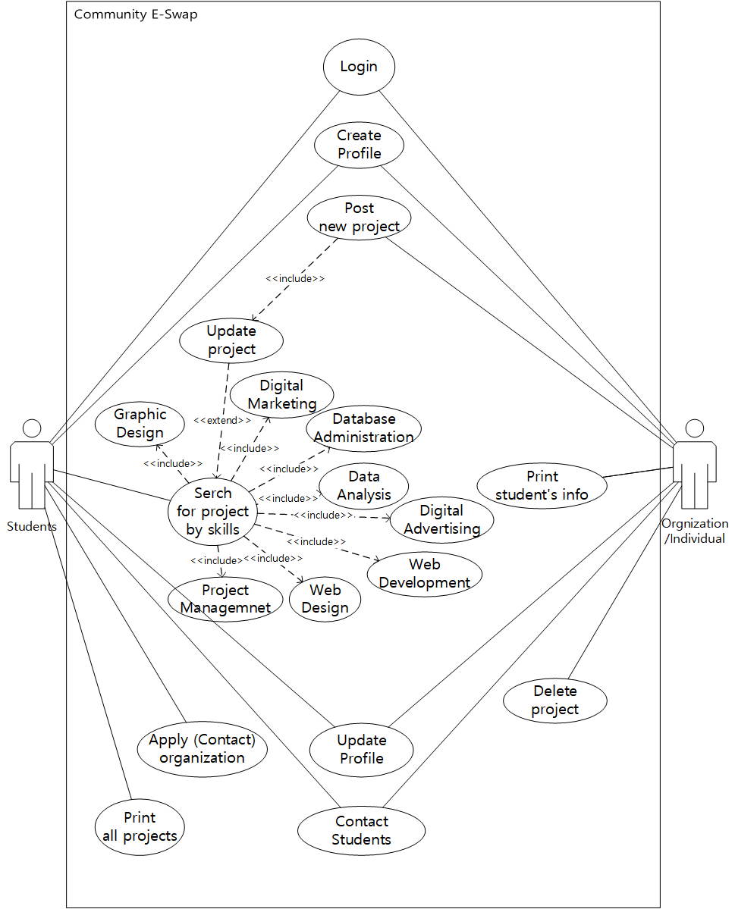
1. Project Overview
Students and recent Graduates Lacking
Hands-on Experience
2. Functional Requirements/ Use Cases
This application is for current computer science students and recent graduates in order to build up their experience portfolio and help community with their talent, knowledge and skills. Also non-profit community organization or individuals who cannot afford high budget technical services can use this application to search for students who can volunteer or provide services for exchange of assets such as venue, instruments, use of truck etc.(Or it could be more cost effective compared to market price).
The students can create a profile with level of proficiency and skillsets. For community organizations or individuals can post projects and find the best students who can get the job done. Our application provides mutual benefits for community and its
young people with high potential.
The database for the project will be implemented using MS SQL Server 17, GUI will be created with
.NET C#(Window Forms). Also we will use
MS Visual Studio(ver. 15.9.11) as IDE.

Slide 3
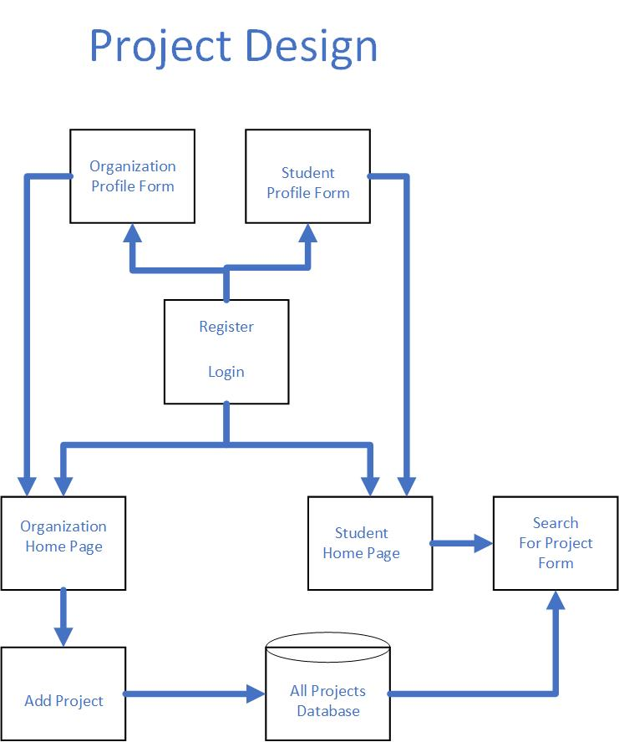
3. Project Design
4. Work Assignments
Name | Features | Classes
Shannon Lim | Output to text Add Project Form Build Database Implement Business Logic | Project
Minjung Shim | Search Project (by category, skills, causes) GUI Implement Business Logic | Organization
Hatim Sayanwala | Login and Registration (Validation) and Profiles Implement Business Logic | Student/ Login

